Slide 1



CROP YIELD PREDICTION: CAN AI FEED THE WORLD?
Sara Díaz del Ser
2023

Slide 2
CONTENTS
INTRODUCTION
The Problem With Agriculture
What Is Machine Learning?
How Can Machine Learning Help?
MY PROJECT: CROP YIELD PREDICTION
Goals
Methodology
Results
CONCLUSION
Future Improvements
Summary

Slide 3
INTRODUCTION
Notes:
There are 8 billion people in the world right now. And by 2050, that number is expected to reach 9.7 billion.
That's a lot of mouths to feed!
The current agricultural system is already struggling to keep up, but what if I told you that there might be a solution? In this presentation, I'll show you how we can use the power of artificial intelligence and machine learning to revolutionize agriculture and create a sustainable food system for generations to come.”

Slide 4
CONTENTS
INTRODUCTION
THE PROBLEM WITH AGRICULTURE
WHAT IS MACHINE LEARNING?
HOW CAN MACHINE LEARNING HELP?
MY PROJECT: CROP YIELD PREDICTION
CONCLUSION
More Mouths, Same Planet
The Current System is Unsustainable
The Layers of Artificial Intelligence
Machine Learning: Tasks
Machine Learning: Types
Machine Learning: Life Cycle
Machine Learning: Advantages
Applications
Case Uses

Slide 5
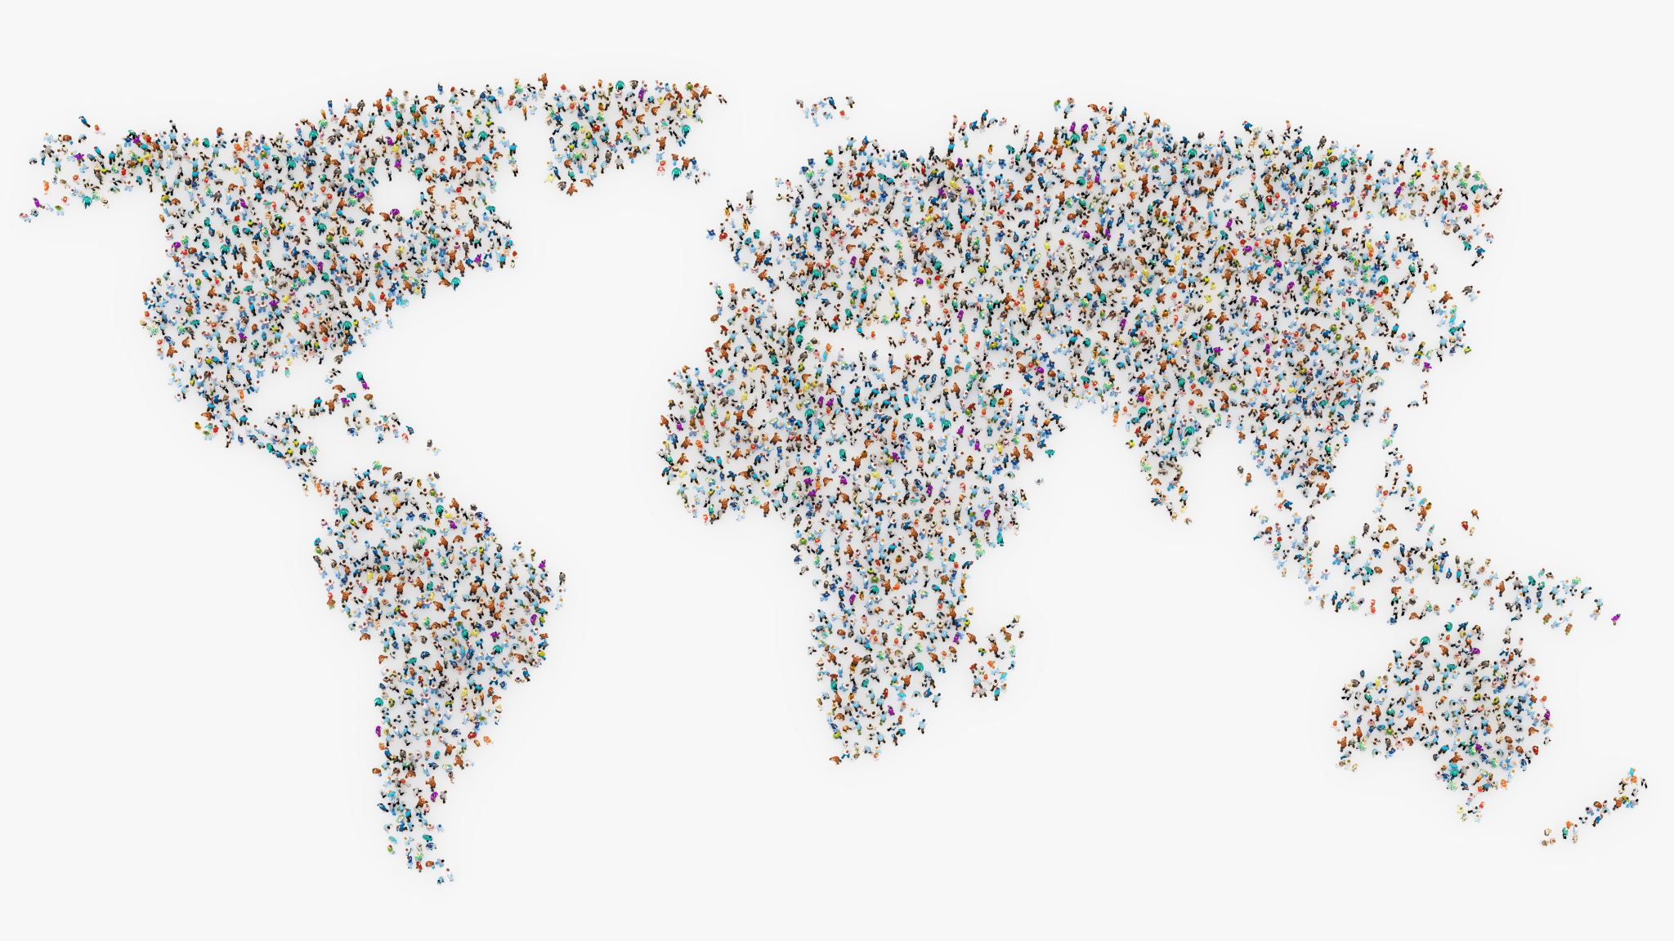
8 000 000 000
Notes:
There are 8 billion people in the world right now.
And by 2050, that number is expected to reach 9.7 billion.
That's a lot of mouths to feed!

Slide 6

THE PROBLEM WITH AGRICULTURE
Notes:
Agriculture is one of the most important industries in the world, providing food and raw materials for human consumption and industrial use. However, the current agricultural system is facing several challenges that threaten its sustainability, including population growth, climate change, and resource depletion.

Slide 7
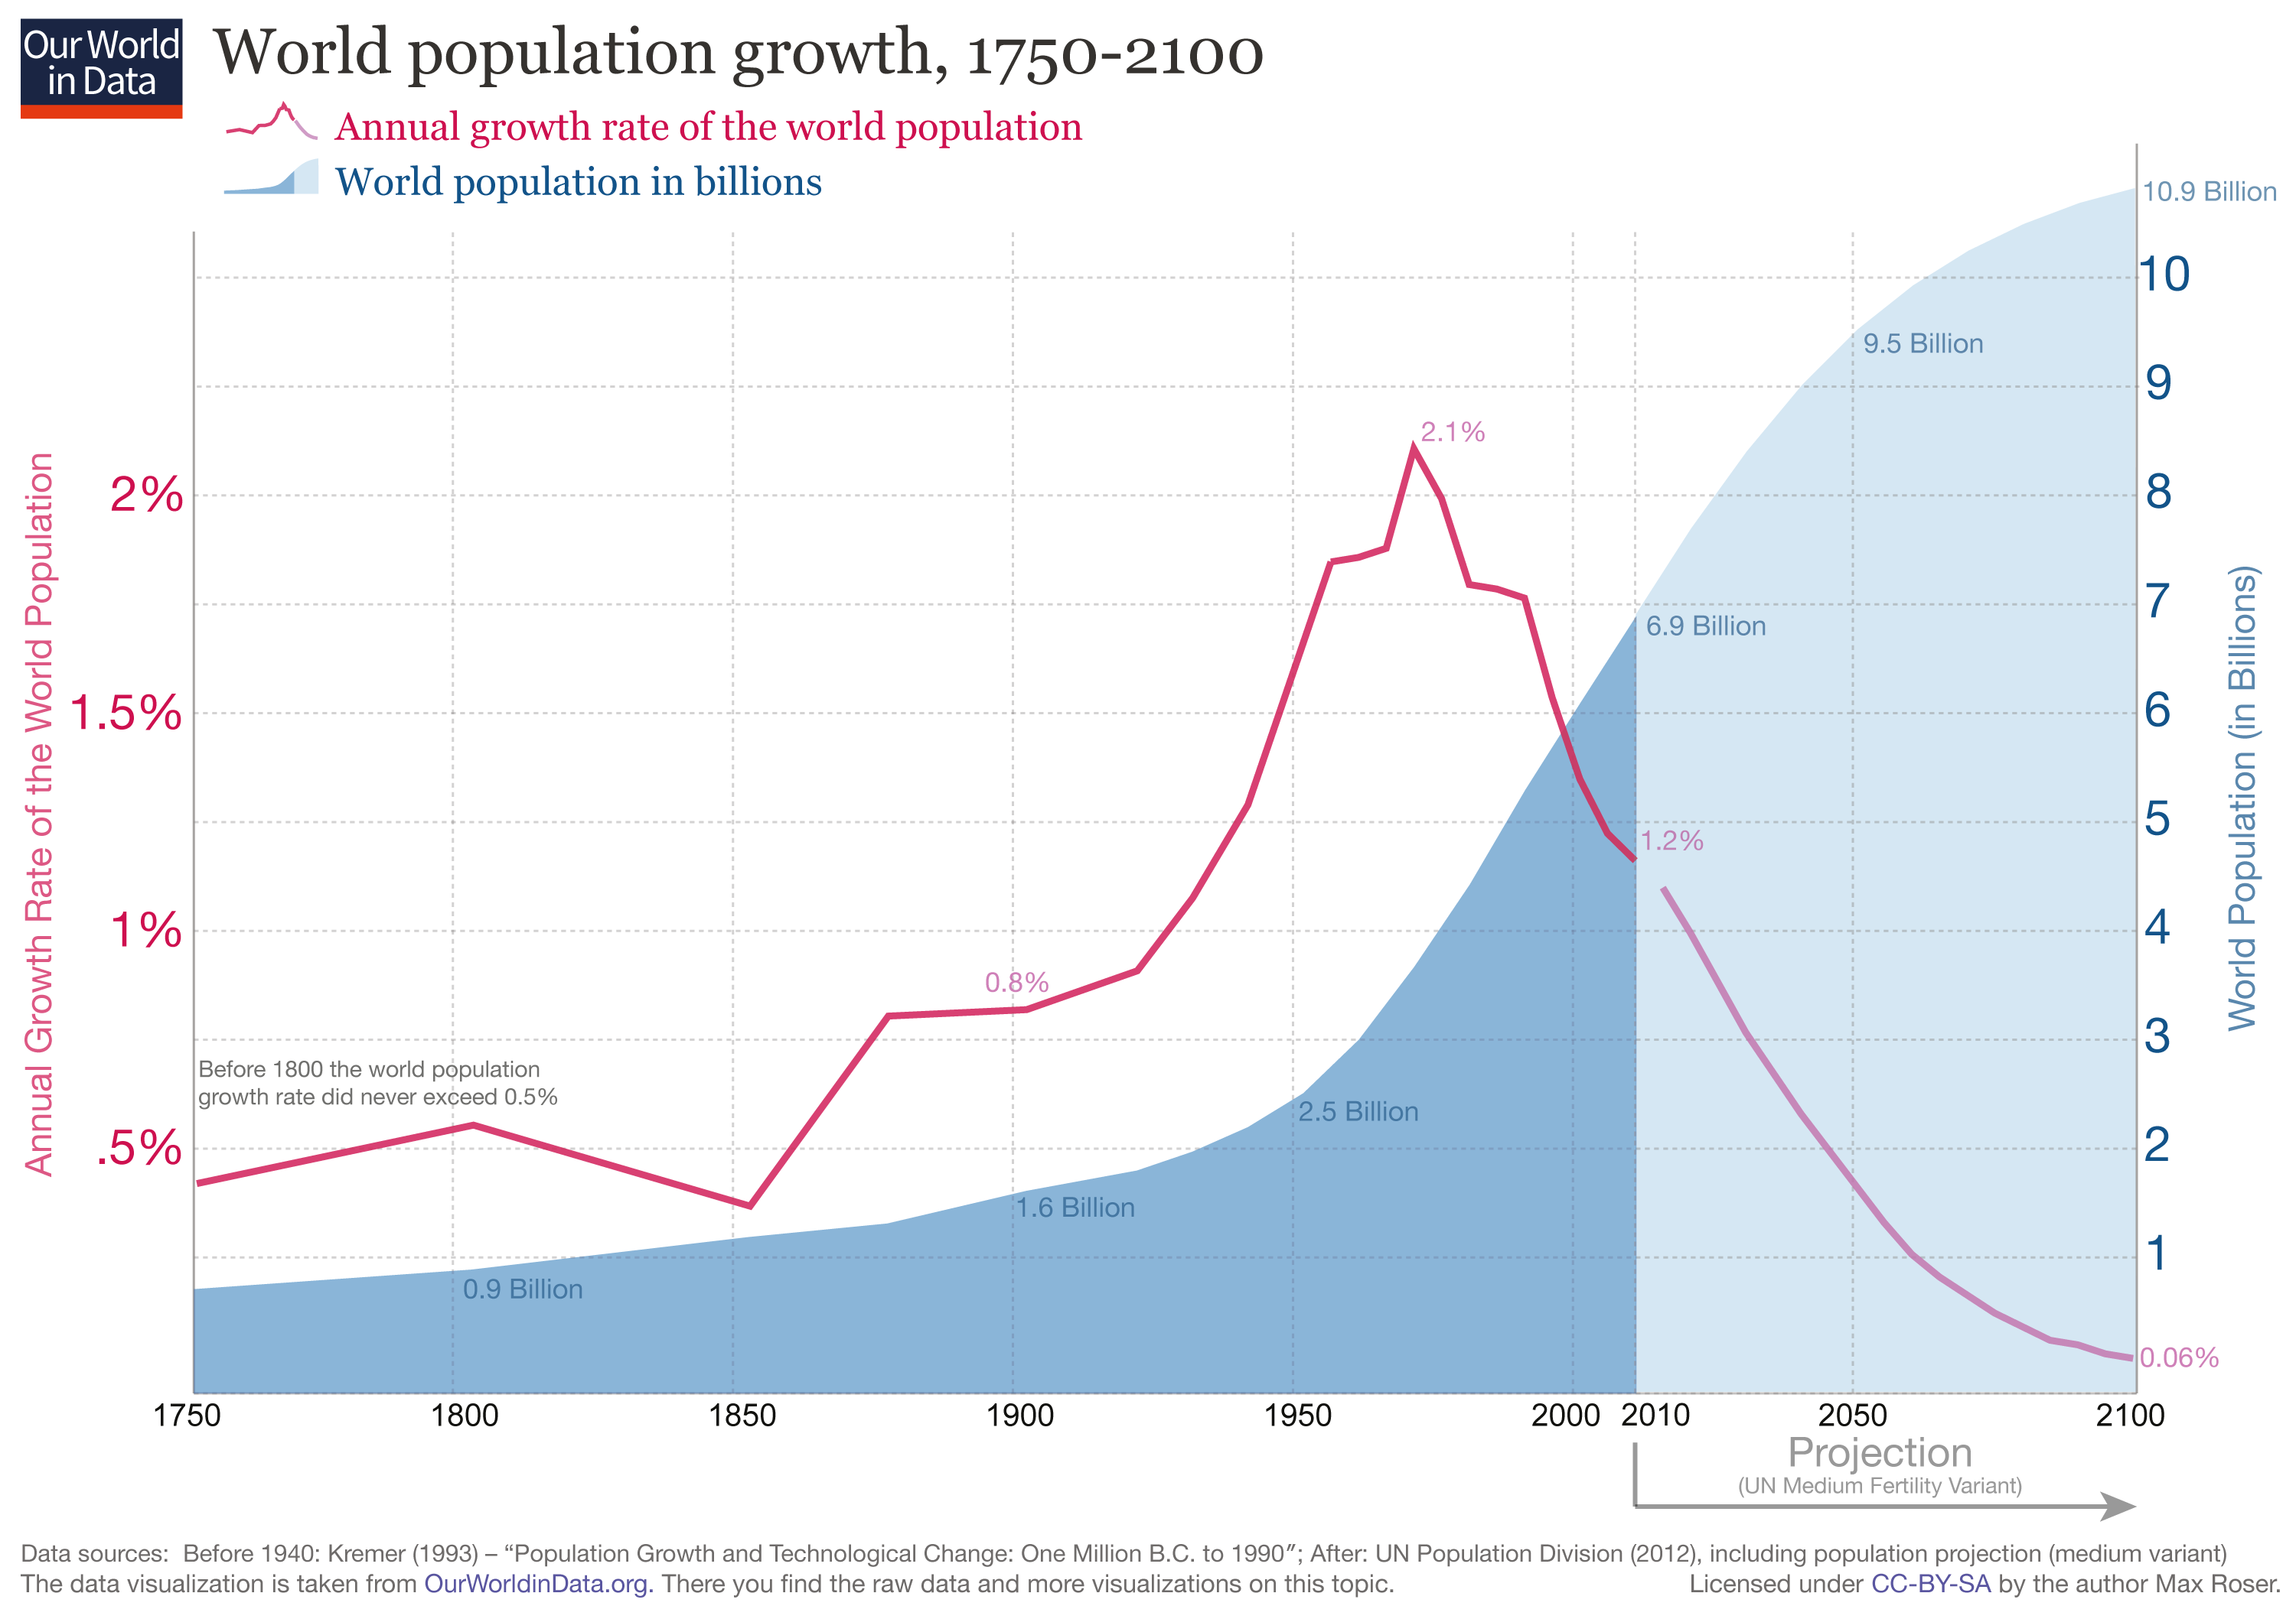
More mouths, same planet.
Notes:
According to the United Nations, the global population is expected to reach more than 9.5 billion by 2050, and nearly 11 billion by the end of the century (UN, 2019). This exponential population growth poses a significant challenge to the agricultural sector, as it is estimated that food production must increase by 70% to feed the world's population by 2050 (FAO, 2009).

Slide 8
THE CURRENT AGRICULTURAL SYSTEM IS UNSUSTAINABLE
DEPLETING resources
ENVIRONMENTAL IMPACT
Climate change
Economic and social ISSUES
health PROBLEMS
Notes:
The current agricultural system is unsustainable for several reasons. Firstly, the system is heavily reliant on finite resources, such as water and fossil fuels. The intensive use of these resources has led to their depletion and has caused negative environmental impacts such as soil degradation and water pollution. This, in turn, has decreased the productivity and the quality of land and water resources, threatening the long-term viability of the agricultural system.
Secondly, the current system is heavily dependent on chemical inputs, such as fertilizers and pesticides, to increase productivity. However, these inputs have negative environmental and health impacts. For example, the excessive use of fertilizers can lead to soil degradation and water pollution, while the overuse of pesticides can lead to pest resistance, the contamination of water resources, and the loss of biodiversity.
Thirdly, the current agricultural system is vulnerable to climate change. Climate change has brought about unpredictable weather patterns, including droughts, floods, and extreme temperatures, which have negatively affected crop yields and food security. Climate change has also increased the incidence of pests and diseases that affect crops, making it more difficult for farmers to sustainably produce food.
Fourthly, the current system has created economic and social challenges. The concentration of agricultural production in large-scale commercial operations has led to the displacement of small farmers and rural communities, causing social disruption and economic inequality. Additionally, the current system is often characterized by market-driven policies that prioritize profits over sustainability, often leading to environmental degradation and social injustice.
Finally, the current agricultural system has led to negative health outcomes, both for workers in the agricultural industry and for consumers of agricultural products. Exposure to pesticides and other chemicals used in agriculture has been linked to a range of health problems, including cancer, respiratory disease, and birth defects. Additionally, the concentration of food production in large-scale commercial operations has led to the production of low-quality, processed foods that are high in fat, sugar, and salt, contributing to the global obesity epidemic.
In summary, the current agricultural system is unsustainable due to its heavy reliance on finite resources, its dependence on chemical inputs, its vulnerability to climate change, its economic and social challenges, and its negative health outcomes. It is clear that a more sustainable approach to agriculture is needed to ensure the long-term viability of the system and to meet the needs of a growing global population.

Slide 9

WHAT IS MACHINE Learning?

Slide 10
The LAYERS OF ARTIFICIAL INTELLIGENCE
ARTIFICIAL INTELLIGENCE
Artificial Intelligence (AI)
Mimics human behavior; any technique that enables machines to solve a task in a way like humans do
MACHINE
LEARNING
Machine Learning (ML)
Algorithms that allow computers to learn from examples without being explicitly programmed
DEEP LEARNING
Deep Learning (DL)
Subset of ML, using deep artificial neural networks as models, inspired by the structure and function of the human brain

Slide 11
machine learning: tasks
CLASSIFICATION
REGRESSION
CLUSTERING

Slide 12
machine learning: TYPES
CLASSIFICATION
REGRESSION
CLUSTERING
C
T
C
T
C
C
2
5
3
4
1
4
5
2
3
C
T
1
SUPERVISED
UNSUPERVISED

Slide 13
Machine leaRning: LIFE CYCLE
From the real world
Model comparison and selection
Data
Build
Train
With preprocessed data
Deploy
Test
In the real world
With different data

Slide 14






Machine leaRning: AdVANTAGES
Ability to handle large and complex datasets.
Scalability
Speed
Flexibility
Continuous learning
Efficiency
Notes:
Machine learning has several advantages in solving complex problems, including:
Ability to handle large and complex datasets: Machine learning algorithms can handle large and complex datasets that may be difficult for humans to analyze.
Scalability: Machine learning algorithms can scale to handle increasing amounts of data and can be applied to a wide range of problems.
Speed and efficiency: Machine learning algorithms can quickly analyze large amounts of data and provide insights that would be time-consuming or impossible for humans to obtain.
Flexibility: Machine learning algorithms can be applied to a wide range of problems across different industries and domains.
Continuous learning: Machine learning algorithms can continuously learn and improve as they receive more data, allowing for ongoing optimization and better performance over time.

Slide 15

HOW CAN MACHINE LEARNING HELP?

Slide 16
ML IN AGRICULTURE: CASE APPLICATIONS
Crop Yield Prediction
Precision Farming
Disease and Pest Detection
Livestock Management
Water Management
Land Optimization
Notes:
There are several applications of machine learning in agriculture that have already been implemented and shown promising results. Here are a few examples:
Crop yield prediction: Machine learning algorithms have been used to predict crop yields in real-time based on weather patterns, soil conditions, and other environmental factors.
Disease and pest detection: Machine learning algorithms can analyze images of crops to detect signs of disease or pest infestation
Precision farming: Machine learning can be used to optimize crop management by adjusting fertilizer application rates or identifying areas of a field that require more attention.
Livestock management: Machine learning algorithms can analyze data from sensors attached to livestock to monitor their health and well-being.
Water management: Machine learning can be used to optimize water management in agriculture, such as by predicting water demand and identifying areas of a field that require more or less irrigation.
6. Land optimization. Machine learning can be used to optimize resource management, such as land, using data collected from sensors.

Slide 17
ML IN AGRICULTURE: CASE STUDIES
Crop Yield Prediction
By analyzing historical data on weather patterns, soil conditions, and crop yields, we can develop models that accurately predict crop yields in real-time.
Precision Farming
By using data from sensors and other sources, ML can help farmers optimize crop management, such as by adjusting fertilizer application rates or identifying areas of a field that require more attention.
Disease and Pest Detection
By analyzing images of crops, ML algorithms can identify signs of disease or pest infestation, alerting farmers to potential issues before they become widespread.
Notes:
Machine learning can be used to improve agricultural productivity in several ways.
One key application is in predicting crop yields, which can help farmers make informed decisions about planting, harvesting, and crop management. By using machine learning algorithms to analyze historical data on weather patterns, soil conditions, and crop yields, researchers can develop models that accurately predict crop yields in real-time.
Another application of machine learning in agriculture is in precision farming. By collecting data from sensors and other sources, machine learning algorithms can help farmers optimize crop management, such as by adjusting fertilizer application rates or identifying areas of a field that require more attention.
Machine learning can also be used to detect diseases and pests in crops, allowing farmers to take proactive measures to prevent or mitigate damage. By analyzing images of crops, machine learning algorithms can identify signs of disease or pest infestation, alerting farmers to potential issues before they become widespread.

Slide 18
MY PROJECT: CROP YIELD PREDICTION

Slide 19
CONTENTS
INTRODUCTION
MY PROJECT: CROP YIELD PREDICTION
CONCLUSION
GOALS
METHODOLOGY
Libraries and Frameworks Used
Model Selection
Training
Deployment
RESULTS
App Prototype
Testing
Data Collection

Slide 20

GOALS

Slide 21



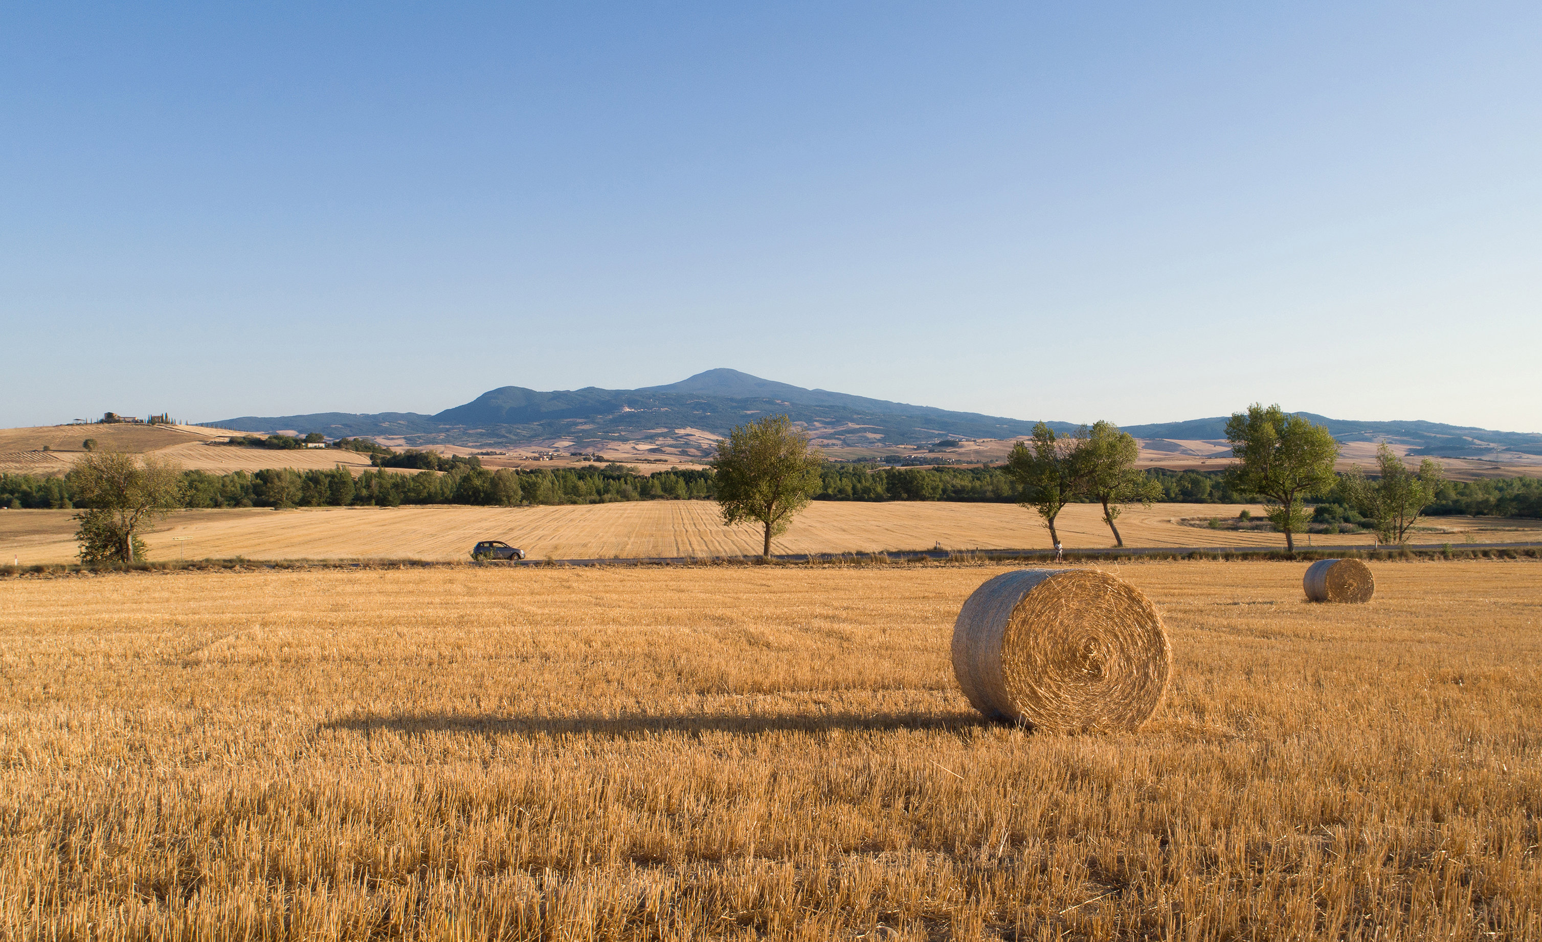

PROJECT GOALS
Find Relevant Features in Data
Select and Train a Model to Predict Crop Yield
Create and Deploy A Mobile Application

Slide 22

METHODOLOGY

Slide 23

1. DATA COLLECTION
2. MODEL SELECTION
5. DEPLOYMENT
4. TESTING
3. TRAIN
PROJECT PIPELINE: STEPS

Slide 24





LIBRARIES & FRAMEWORKS USED
DATA COLLECTION
MODEL SELECTION
DEPLOYMENT
TESTING
TRAIN

Slide 25


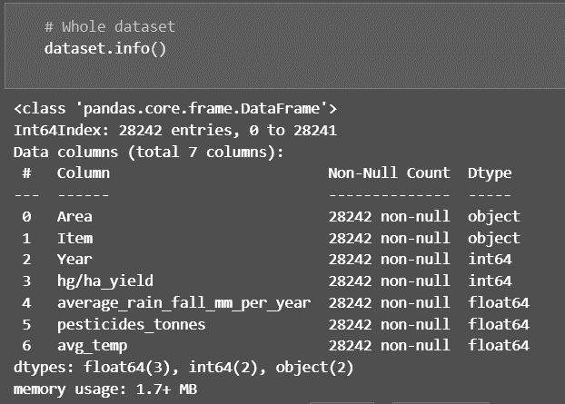






STEP 1: DATA COLLECTION
'Area' (categorical)
Country or area where the crop yield data is recorded.
It provides a geographical context to analyze and compare crop yields across different regions.
'Item' (categorical)
Crop type being measured.
It allows for the analysis and prediction of specific crops individually.
'Year' (numerical)
Year in which the crop yield data is recorded.
It provides a temporal dimension, allowing for the analysis of yield trends over time.
'hg/ha_yield' (numerical)
Yield of the crop in hectograms per hectare. It serves as the target variable for prediction and regression modeling
'average_rain_fall_mm_per_year' (numerical)
This column provides information about the average annual rainfall in millimeters for the given area and year.
Rainfall can significantly impact crop growth and yield.
'pesticides_tonnes' (numerical)
Amount of pesticides used in tonnes in a year.
Pesticides can affect crop health and productivity.
'avg_temp' (numerical)
The average temperature for the given area and year. Temperature influences crop growth and development.
Notes:
Slide: descibir la base de datos, que tipos de datos,

Slide 26
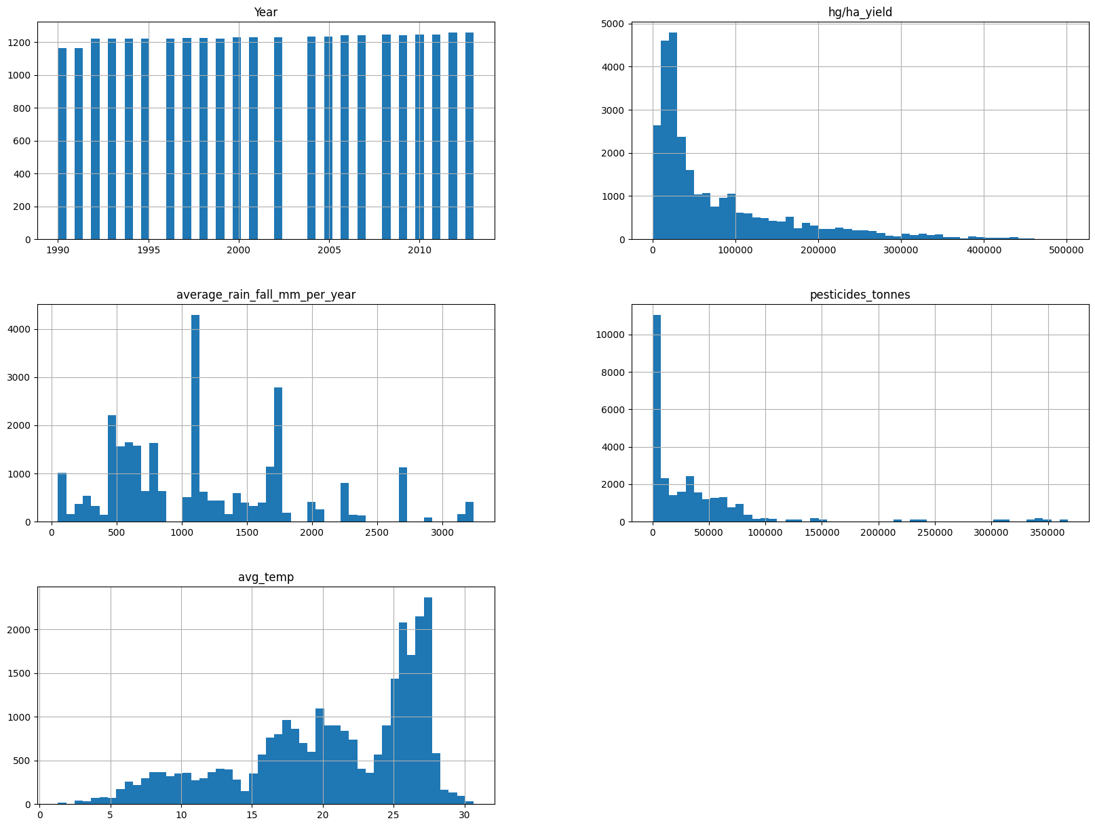
STEP 1: DATA COLLECTION
Notes:
Slide: descibir la base de datos, que tipos de datos,

Slide 27
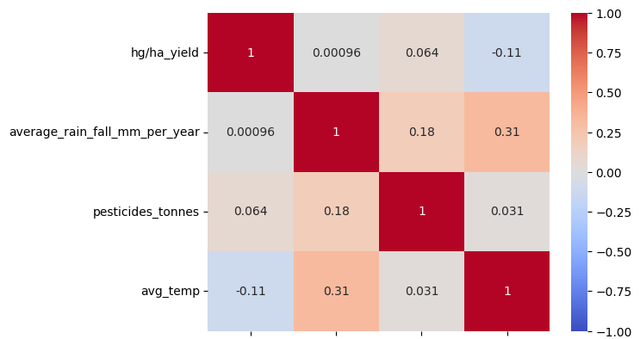
STEP 1: DATA COLLECTION
hg/ha_yield
average_rain_fall
_mm_per_year
pesticides_
tonnes
avg_temp
Notes:
Slide: descibir la base de datos, que tipos de datos,

Slide 28
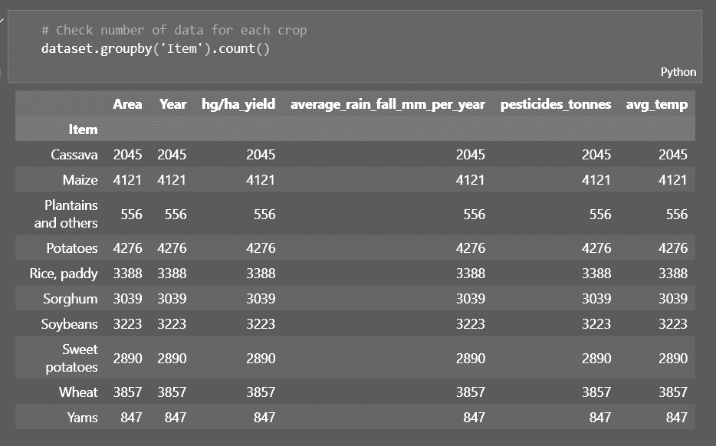
STEP 1: DATA COLLECTION
Notes:
Slide: descibir la base de datos, que tipos de datos,

Slide 29

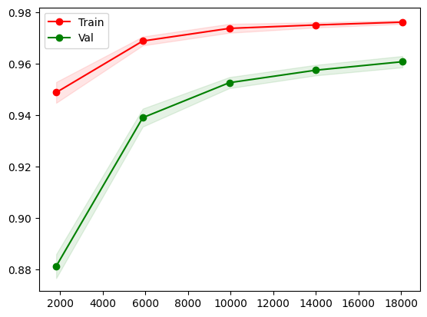
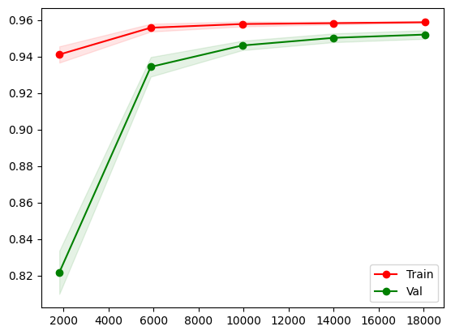
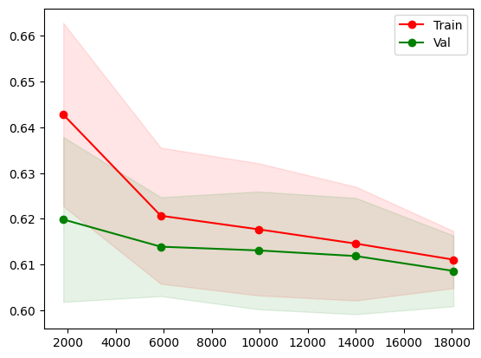
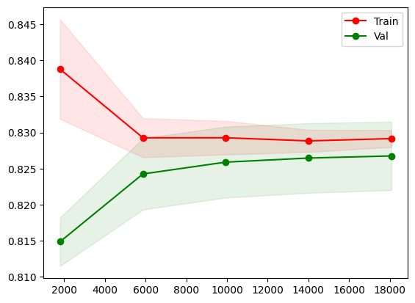
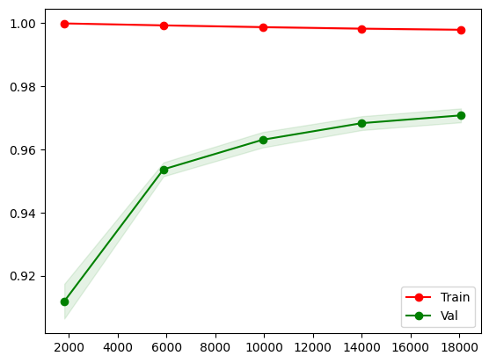
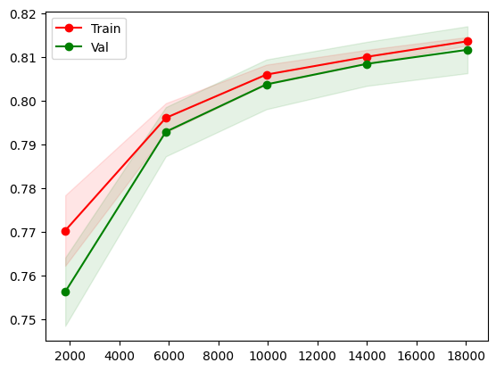
STEP 2: MODEL SELECTION
AdaBoost
Score: 0.60675
R^2: 0.607
MAE: 0.559
MAE(%): 7.18%
Random Forest
Score: 0.965676
R^2: 0.966
MAE: 0.122
MAE(%): 1.56%
SVM
Score: 0.957
R^2: 0.957
MAE: 0.145
MAE(%): 1.86%
Elastic Net
Score: 0.8289
R^2: 0.829
MAE: 0.348
MAE(%): 4.46%
XGradBoost
Score: 0.97562
R^2: 0.976
MAE: 0.093
MAE(%): 1.19%
SGDR Regressor
Score: 0.817395
R^2: 0.817
MAE: 0.359
MAE(%): 4.60%
Notes:
Slide: selecion de modelos (Comparacion por caracteristicas)

Slide 30
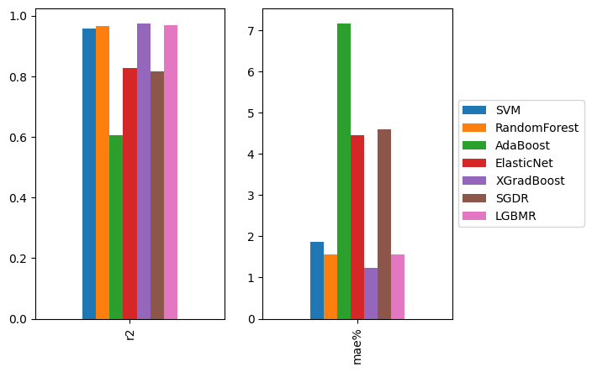
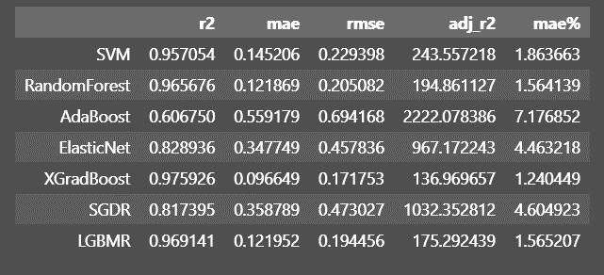
STEP 2: MODEL SELECTION
Notes:
Slide: selecion de modelos (Comparacion por caracteristicas)

Slide 31


STEP 3 & 4: TRAINING & Testing
'rgs__learning_rate': 0.2, 'rgs__max_depth': 12, 'rgs__min_child_weight': 1, 'rgs__n_estimators': 250
XGradBoost
Score: 0.97562
R^2: 0.976
MAE: 0.093
MAE(%): 1.19%
Cassava: R^2=0.92, MAE=0.10, MAE%=2.82%
Maize: R^2=0.93, MAE=0.12, MAE%=2.30%
Plantains+: R^2=0.92, MAE=0.10, MAE%=3.46%
Potatoes: R^2=0.92, MAE=0.08, MAE%=2.28%
Rice: R^2=0.92, MAE=0.08, MAE%=2.16%
Sorghum: R^2=0.92, MAE=0.12, MAE%=2.53%
Soybeans: R^2=0.91, MAE=0.08, MAE%=1.53%
Sweet potatoes: R^2=0.93, MAE=0.09, MAE%=2.32%
Wheat: R^2=0.94, MAE=0.09, MAE%=2.38%
Yams: R^2=0.96, MAE=0.05, MAE%=2.12%
Notes:
Slide: training (steps, splitting dataset, hyperparameter selection)

Slide 32


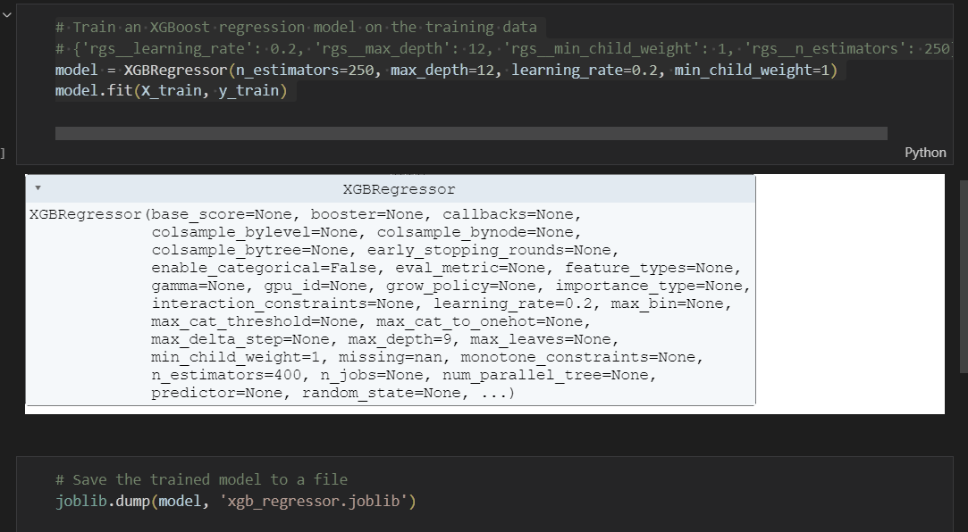
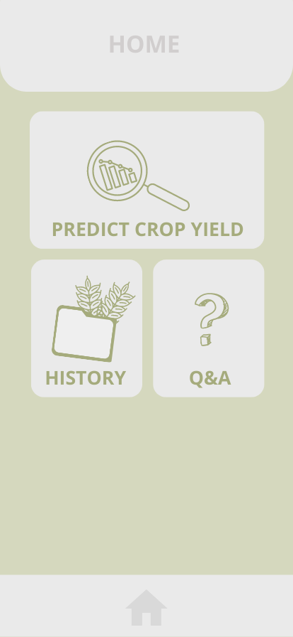
STEP 5: DEPLOYMENT
Notes:
Slides: deployment (canva proptype + react native development pipeline)

Slide 33

RESULTS

Slide 34
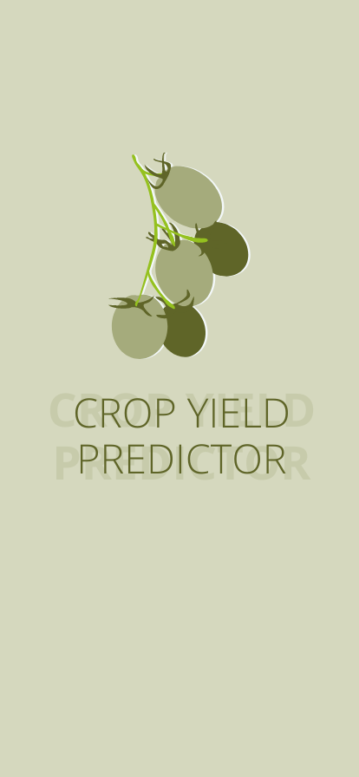
(EXPECTED) RESULTS
10 Crop Types
6 Variables
97,6% Success
Notes:
Screen shot of app

Slide 35
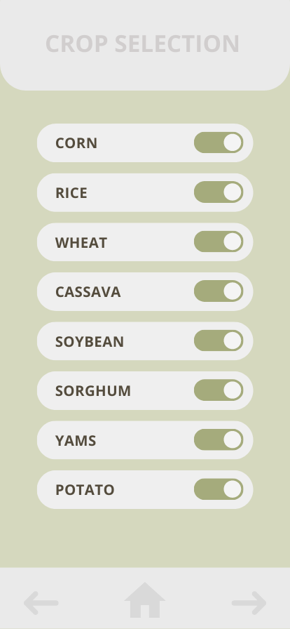
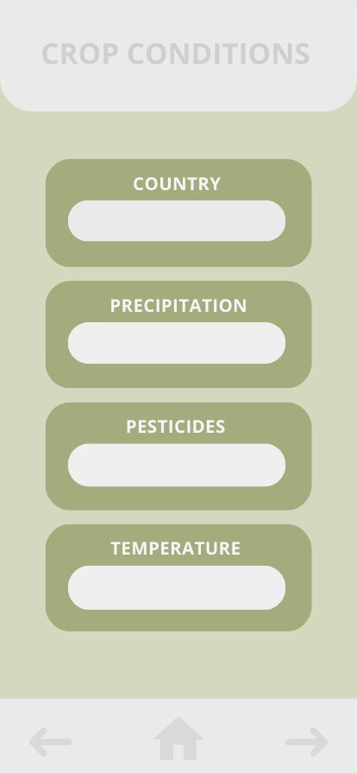
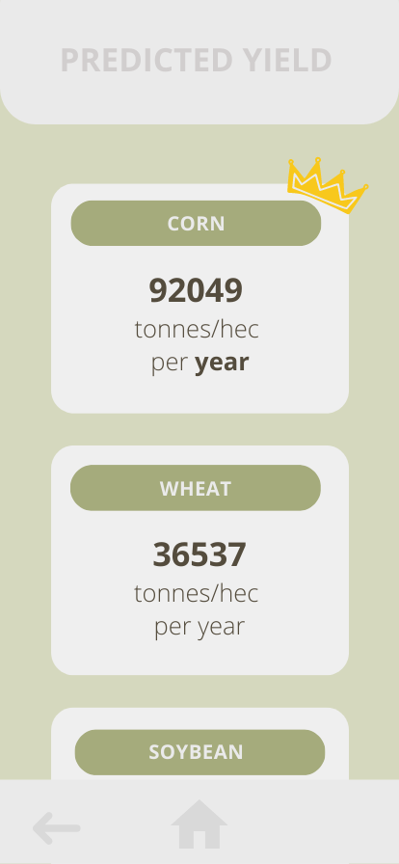
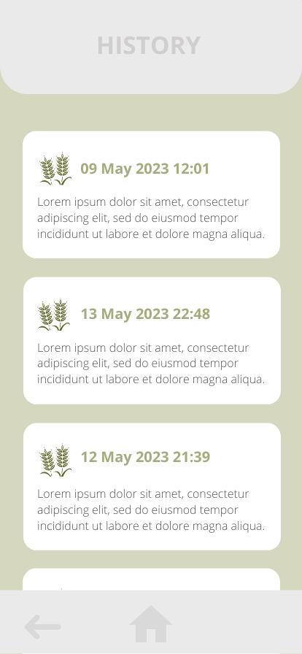
(EXPECTED) RESULTS
Notes:
Screen shot of app

Slide 36
CONCLUSION

Slide 37
CONTENTS
INTRODUCTION
MY PROJECT: CROP YIELD PREDICTION
CONCLUSION
FUTURE IMPROVEMENTS
SUMMARY

Slide 38
Improved Geographical Focus
Seasonal Mean Exploration
Integration of Weather Forecasting
Analysis of Pesticide Effects
Expansion to More Crops or Different
FUTURE IMPROVEMENTS
Notes:
Improved Geographical Focus: The current data used in the crop yield prediction app project was generalized. To enhance accuracy, it would be beneficial to concentrate on a specific geographical area and make predictions that are more tailored to that region. By narrowing down the analysis to a specific area, factors specific to that location, such as soil type, climate, and local agricultural practices, can be considered, resulting in more accurate predictions.
Seasonal Mean Exploration: Instead of relying solely on yearly means, it would be valuable to explore seasonal means in the data analysis. Crop yields can be influenced by various seasonal factors, such as temperature variations, precipitation patterns, and day length. By examining seasonal means, the app can capture the impact of these factors on crop growth and incorporate them into the prediction model. This will enable more nuanced and precise predictions throughout the different seasons.
Integration of Weather Forecasting: Integrating real-time weather conditions into the app would be a significant enhancement. By accessing weather forecasting data, the app can incorporate the latest weather information, such as temperature, rainfall, and humidity, into the prediction model. This dynamic approach will allow the app to provide more accurate and up-to-date predictions based on the current weather conditions, thus enhancing the reliability of the crop yield predictions.
Analysis of Pesticide Effects: In addition to considering the quantity of pesticides used, it would be valuable to investigate how different types of pesticides affect crop yields. Different pesticides have varying modes of action and efficacy against specific pests or diseases. By incorporating information about the specific types of pesticides used, the app can analyze their impacts on crop health and yield. This analysis will provide valuable insights for farmers and agricultural practitioners to optimize pesticide selection and usage for improved crop productivity.
Expansion to More Crops or Different Species: As a future development, it would be beneficial to expand the scope of the app to include more crop types or even different species within the same crop. Currently, the app focuses on a limited number of crops, but expanding the dataset to include a wider range of crops or different genetic varieties within a specific crop would enhance its usefulness and applicability. This expansion will provide farmers and researchers with valuable insights into the performance and potential yield variations across different crops or genetic strains, enabling more informed decision-making and customized recommendations for specific agricultural scenarios.

Slide 39
SUMMARY
The project aimed to:
find and analyze a crop-yield dataset
select and train a regression model for crop-yield prediction
develop an app that provides valuable insights and predictions for agricultural decision-making
Notes:
Screen shot of app

Slide 40

Thank you
saradiazdelser@duck.com

